Slide 1


Slide 2
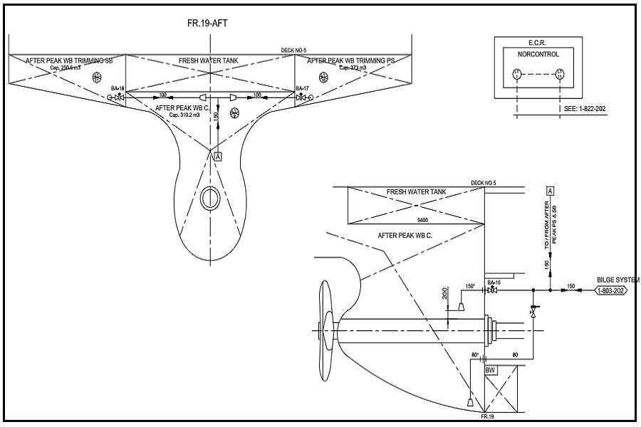

Steel Pipe Fabrication
Largescale 3D scanner for big retrofit project
Handheld 3D scanner for signal pipe replacement
Point cloud reversing and Engineering drawing
Pipe Pre-fabrication and inspection in workshop
Installation on board

Slide 3

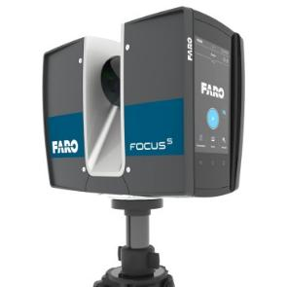
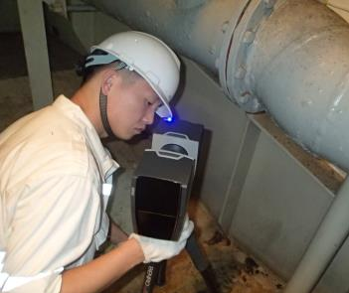
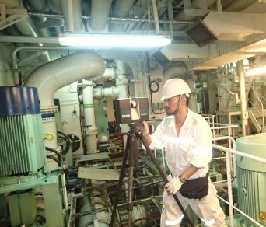
1. Largescale 3D scanner for big retrofit project
This scanning fit for big retrofit project, eg. EGCS, BWTS, ULSFO.
Equipment: FRAO Focus S350.
Engineer: one for feasibility inspection and one for 3D scanning
Time: 1 day 3D scan on board + 14 days for engineering (depends on amount)
Precision: 0-2mm
FARO Focus S350

Slide 4
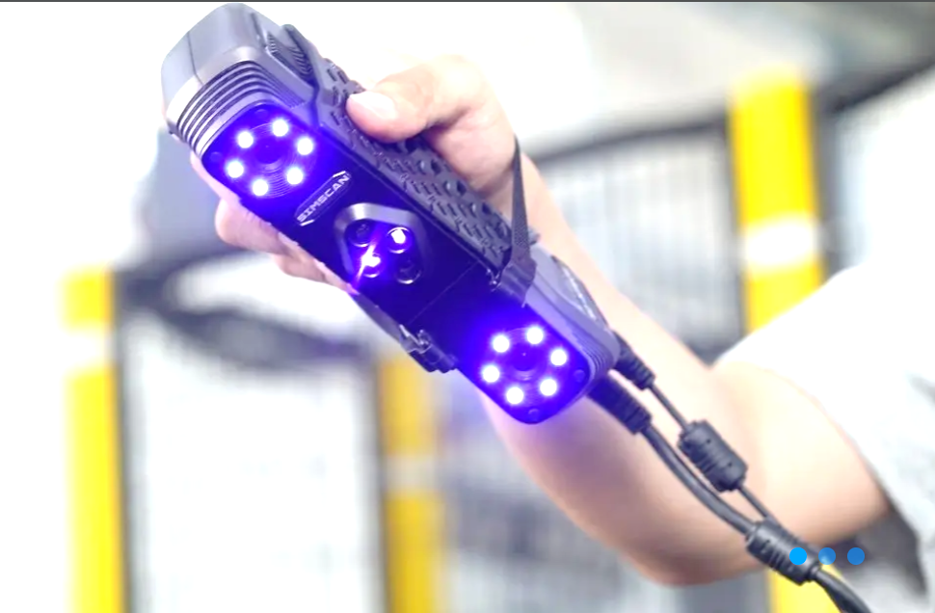
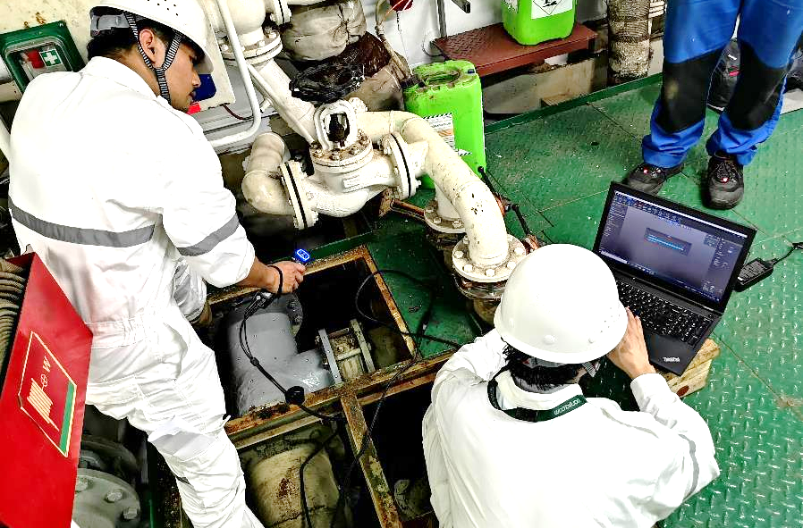
2. Handheld 3D scanner for signal pipe replacement
This scanning fit for single project, eg. single sea water pipe replacement, other non-standard parts copy.
Equipment: SIMSCAN22
Engineer: one for 3D scanning
Time: 1 day 3D scan on board + 7 days for engineering
Precision: 0.1mm

Slide 5

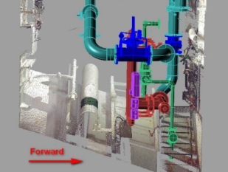
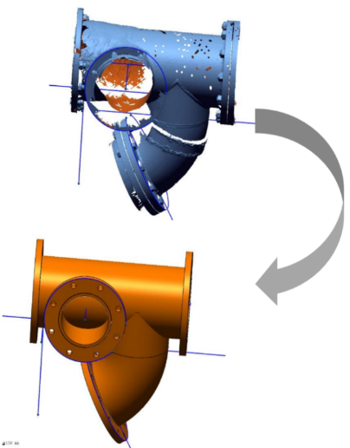
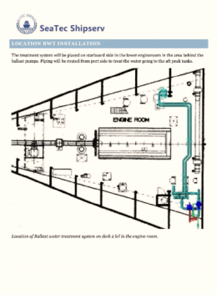
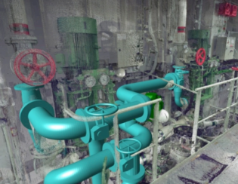
3. Point cloud reversing and Engineering drawing
Based on 3D scanning data and photos, we will make point cloud reversing and make pipe engineering drawing (Isometric)

Slide 6
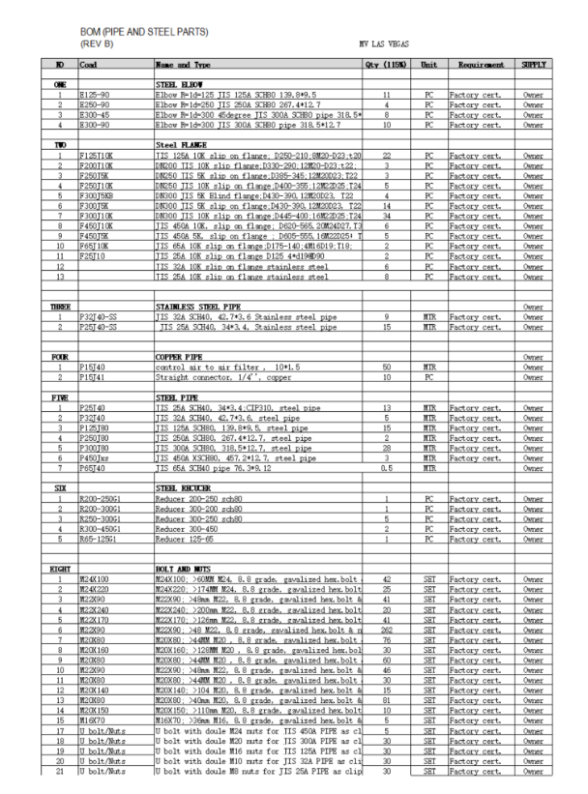
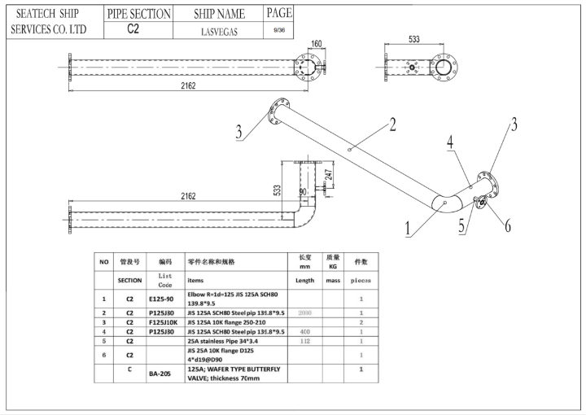
Eg. of Pipe Isometric drawing

Slide 7

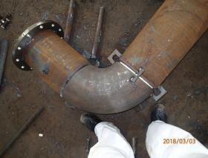
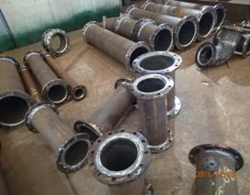
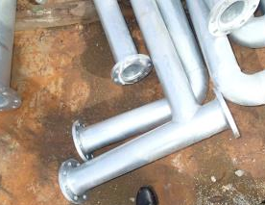
4. Pipe Pre-fabrication and inspection in workshop
Based on Production drawings, our workshop can pre-fabricate the pipes, foundations, supports, and galvanization, prepare the necessary valves, cables, bolts, nuts, gaskets, etc.
Our workshop following by below quality standards:
STS pipe standard QSTS-097-2020
CSQS China Shipbuilding Quality Standard
IACS No.47 Shipbuilding and Repair Quality Standard
IEC Electrical installation in ships standard
GB/T 13912-2002 Hot Dipping Galvanizing

Slide 8

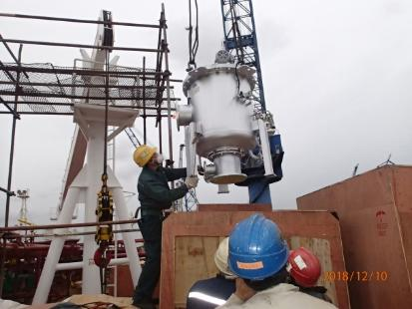
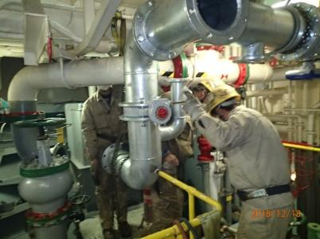
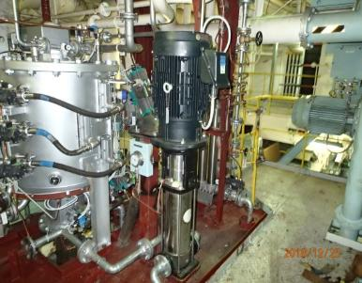
5. Installation on board
We can carry out the installation job on board, we have a team with good experience of pipe, electrical and steel works,
Normally, installation time takes about 10 ~ 12 days for One set of medium size BWTS and 15~ 18days for 2 sets BWTS.

